Slide 1

SMART HOME
Experience the Future: Smart Home Design

Slide 2
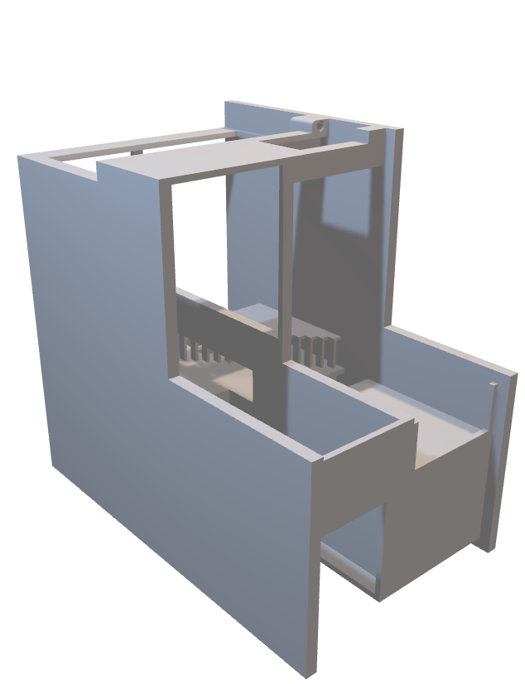
SMART HOME
Experience the Future: Smart Home Design
Imagine a home that anticipates your needs, simplifies your life, and enhances your comfort. A smart home integrates cutting-edge technology to offer unparalleled convenience, energy efficiency, and security all at your fingertips.

Slide 3
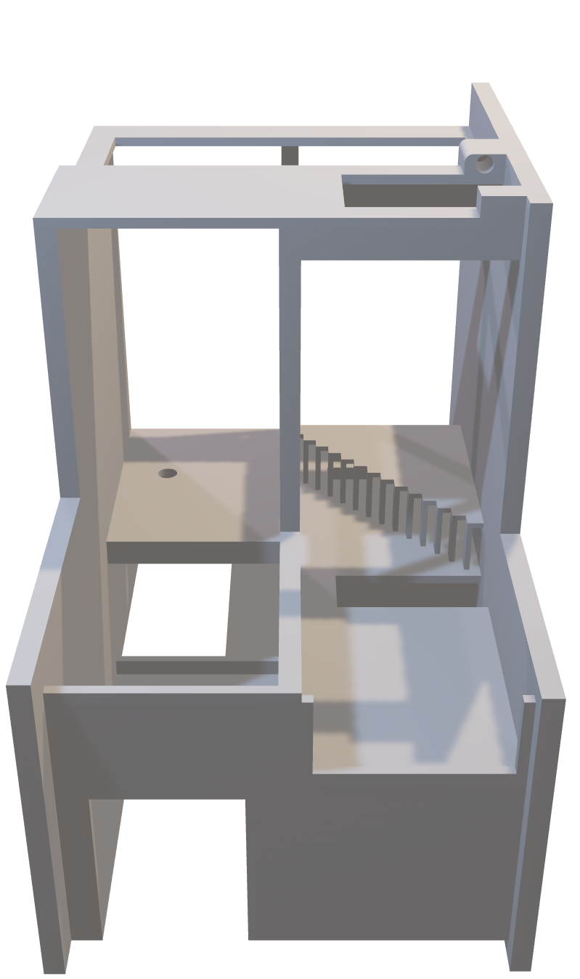
Laser Security
Your Gateway to Modern Living
SMART HOME
Imagine a home that anticipates your needs, simplifies your life, and enhances your comfort. A smart home integrates cutting-edge technology to offer unparalleled convenience, energy efficiency, and security all at your fingertips.
For the safe and dependable protection of property and valuables, laser security systems are a great option. They function by directing laser beams into pre-designated locations, forming an invisible barrier.
Experience the Future: Smart Home Design

Slide 4

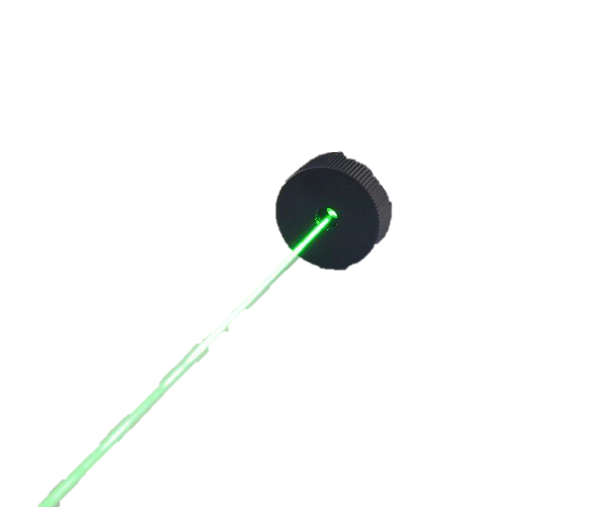
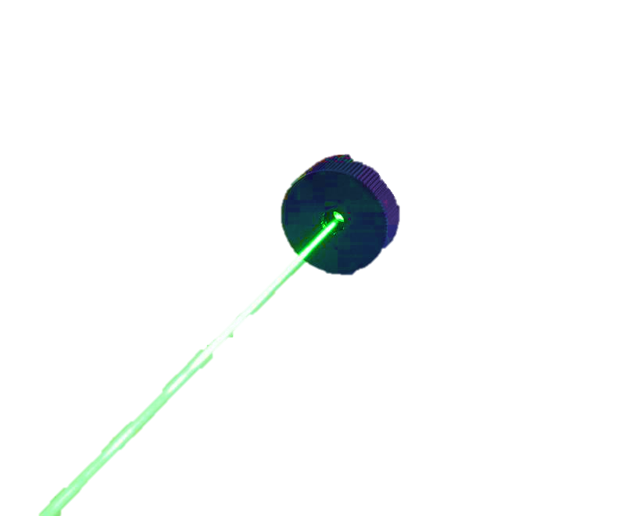
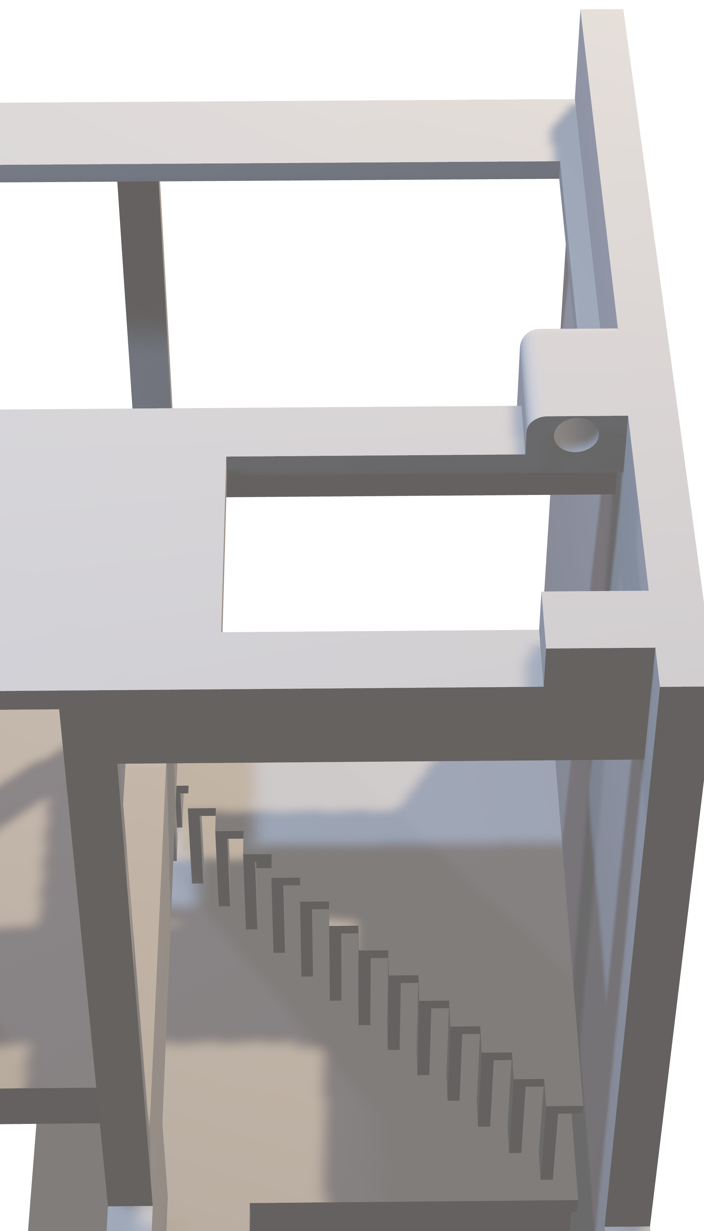
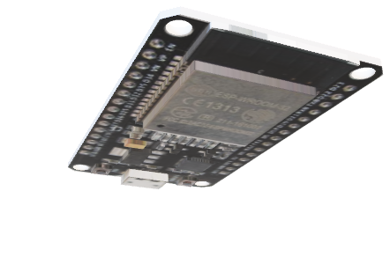
Your Gateway to Modern Living
SMART HOME
Laser Security
Imagine a home that anticipates your needs, simplifies your life, and enhances your comfort. A smart home integrates cutting-edge technology to offer unparalleled convenience, energy efficiency, and security all at your fingertips.
For the safe and dependable protection of property and valuables, laser security systems are a great option. They function by directing laser beams into pre-designated locations, forming an invisible barrier.

Slide 5
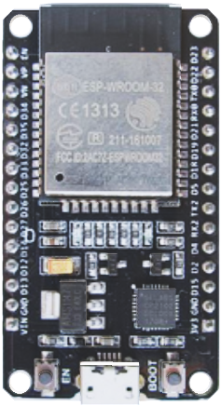
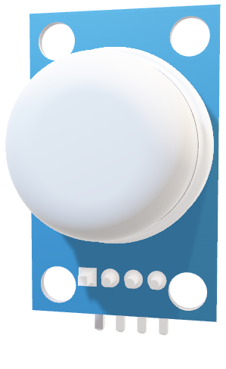
Smoke Detector
Laser Security
Using ESP32 Bluetooth technology, you can effortlessly control a laser security system with your smartphone using Blynk app, ensuring maximum safety and peace of mind for your home.

Slide 6
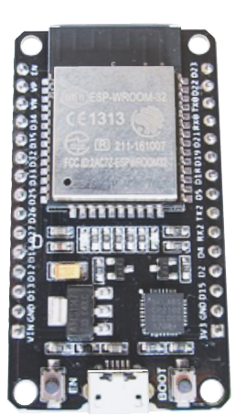


Smoke Detector
Smoke detectors are crucial safety devices that swiftly detect smoke in your home, acting as an early warning system for potential fires. With esp32 and the Blynk app, they instantly send notifications to your phone, keeping you informed and safe wherever you are.

Slide 7

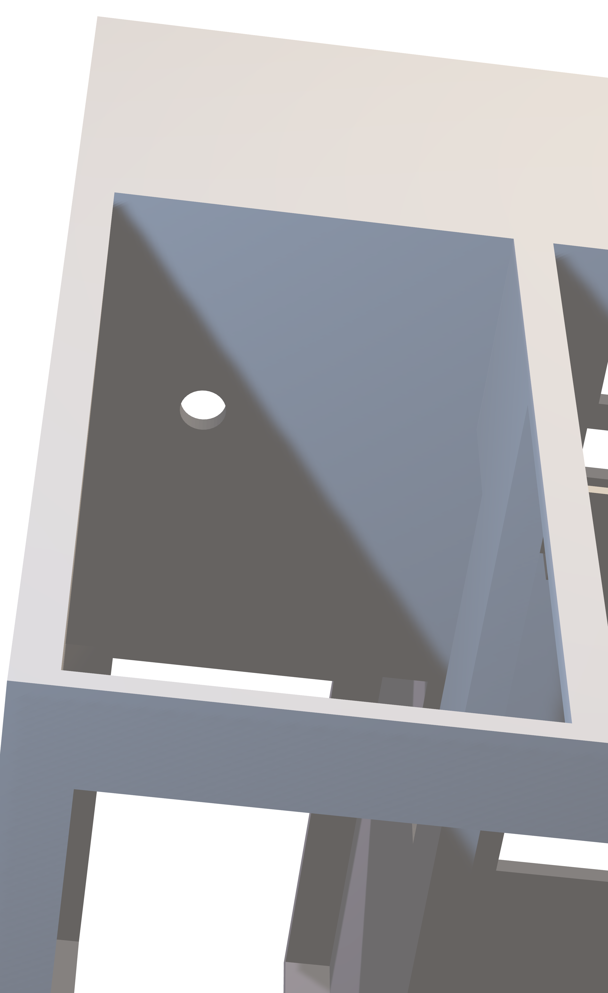
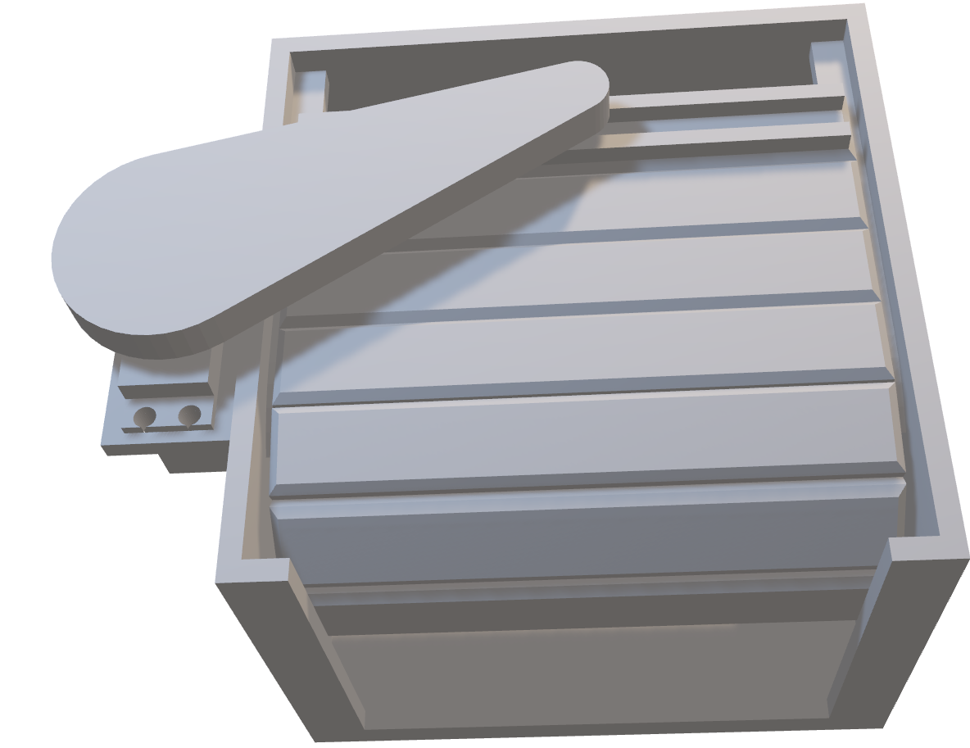
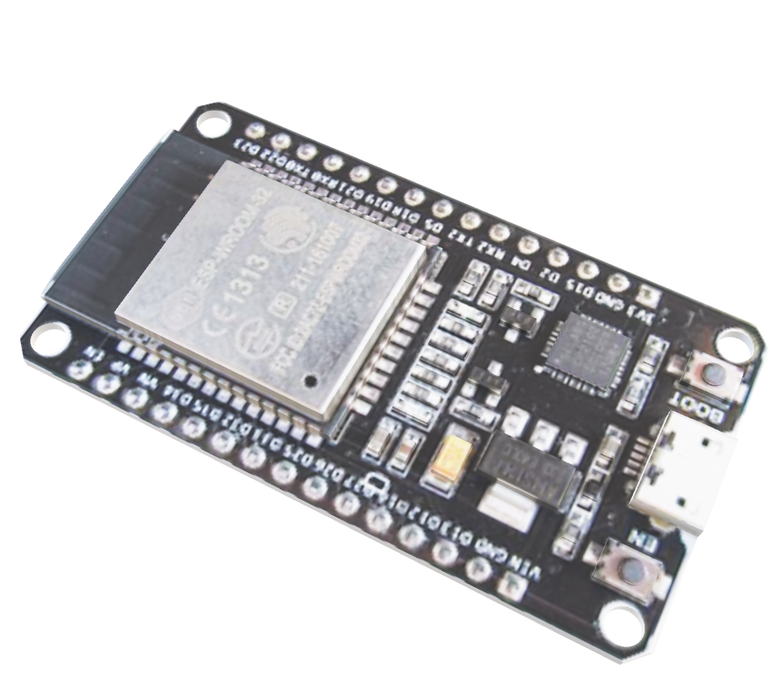
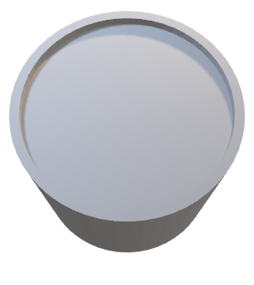
Garage Door
Buzzer
Smoke Detector
To ensure the safety of everyone at home, strategically placed alarm alerts occupants to any danger, providing timely warnings and maximizing protection.

Slide 8
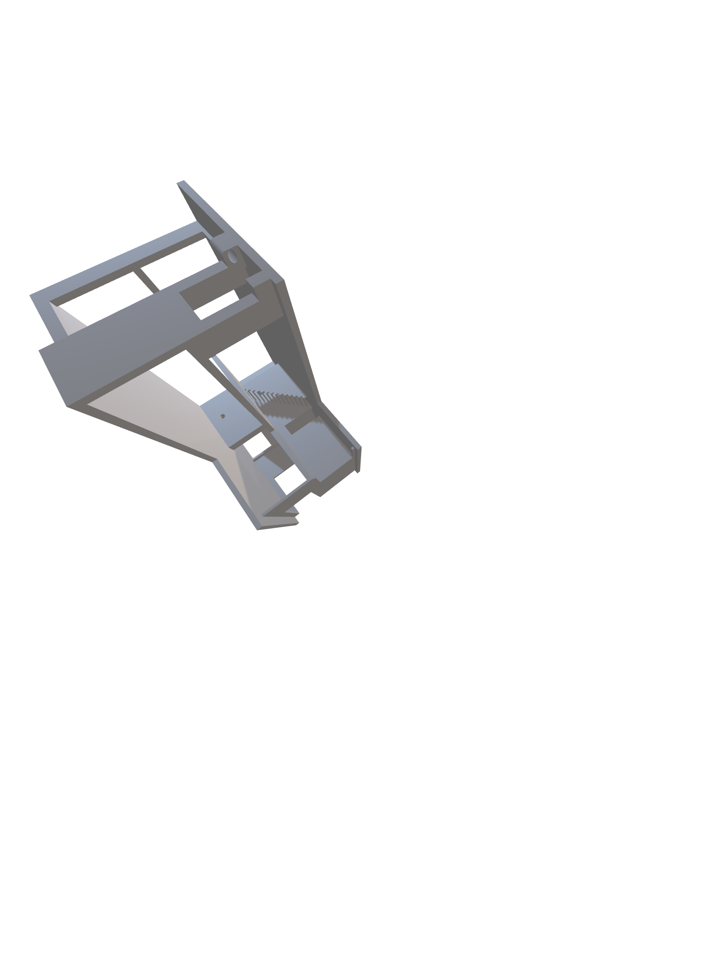
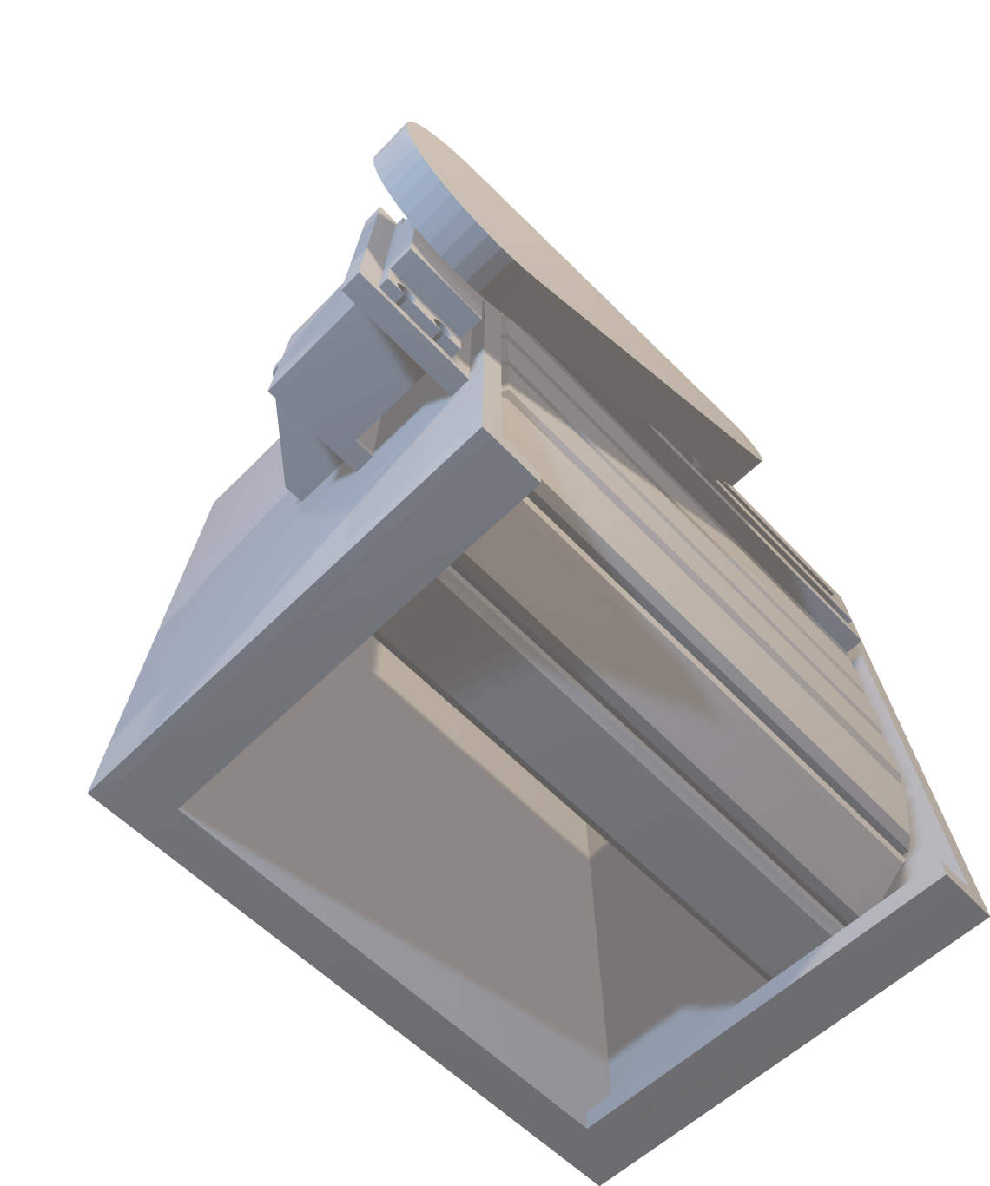
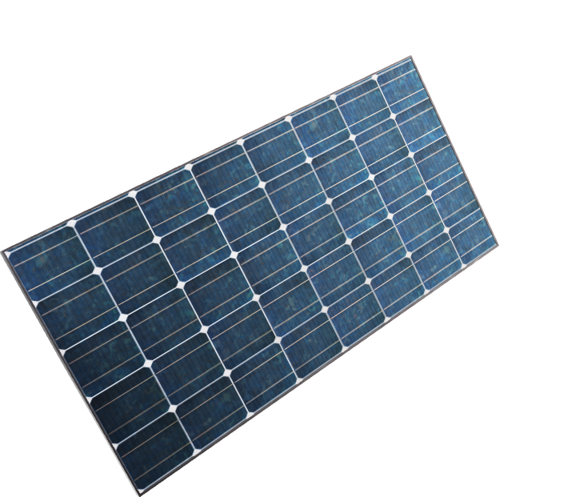

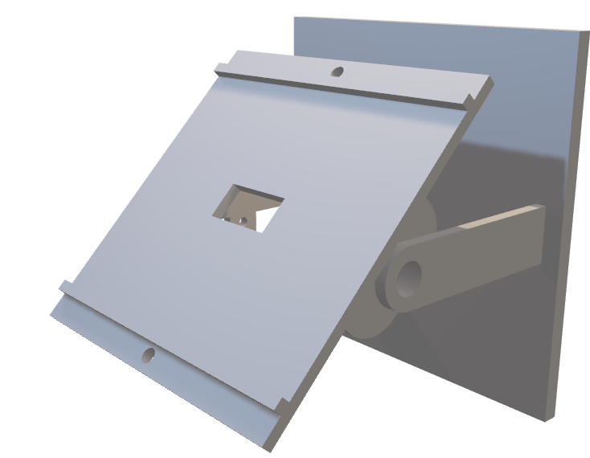
Solar Tracker
Buzzer
Garage Door
Smart garage doors revolutionize home convenience and security by allowing you to open and close them using a remote control (IR) , all while comfortably seated in your car. This innovation enhances both accessibility and safety for homeowners.

Slide 9
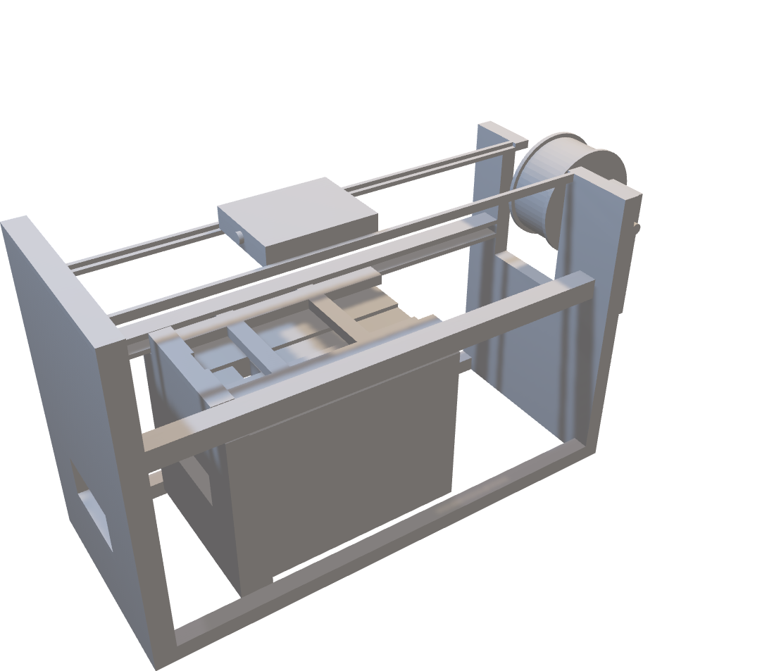
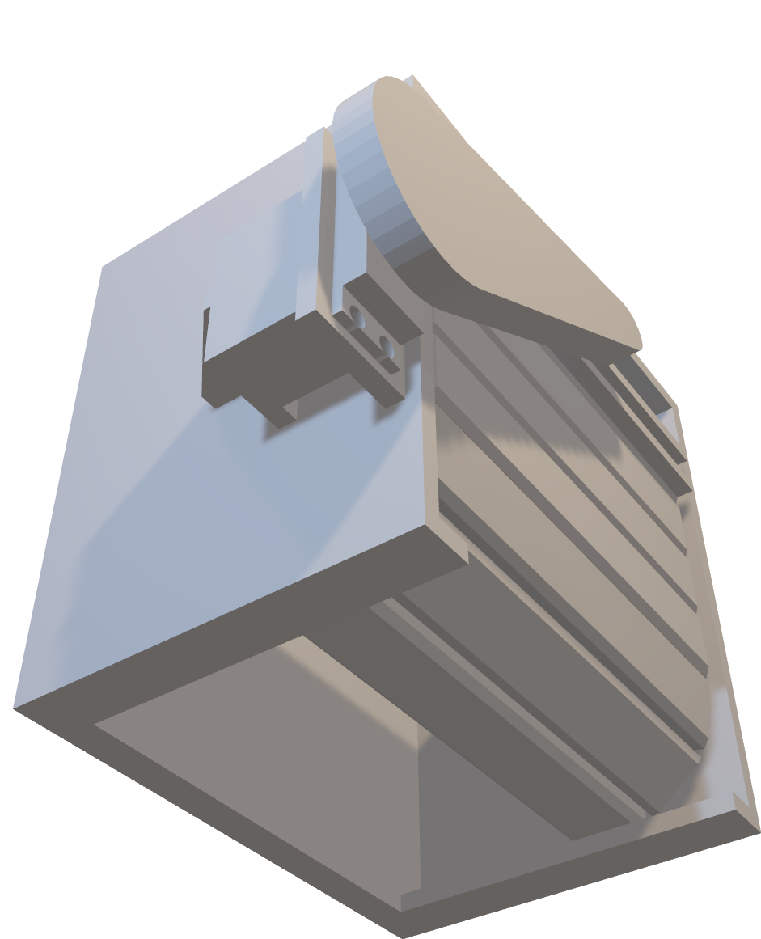
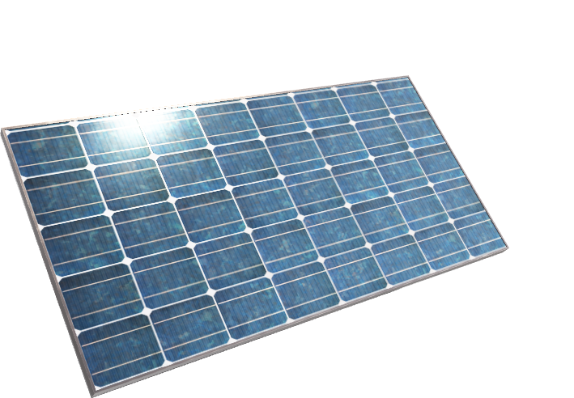
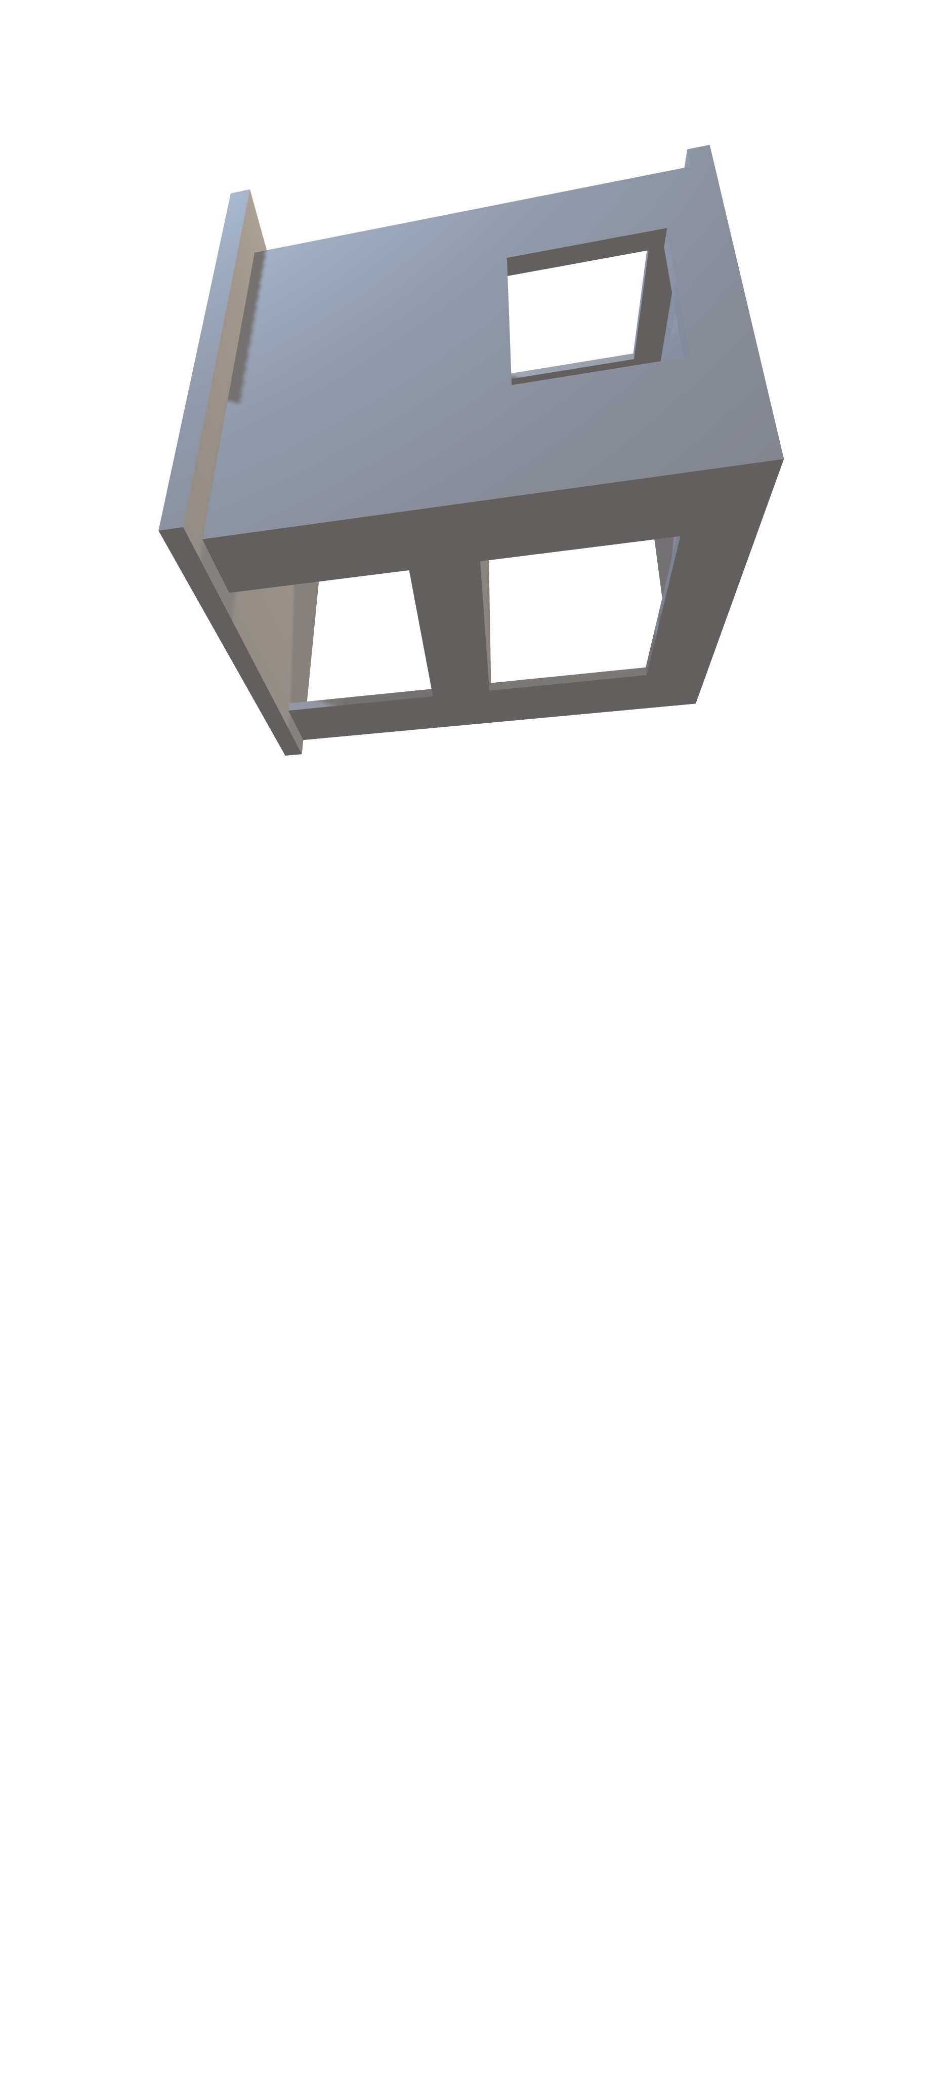
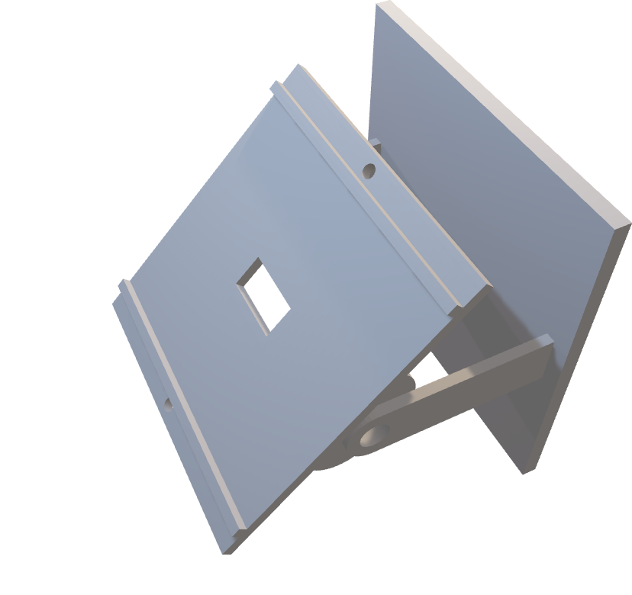
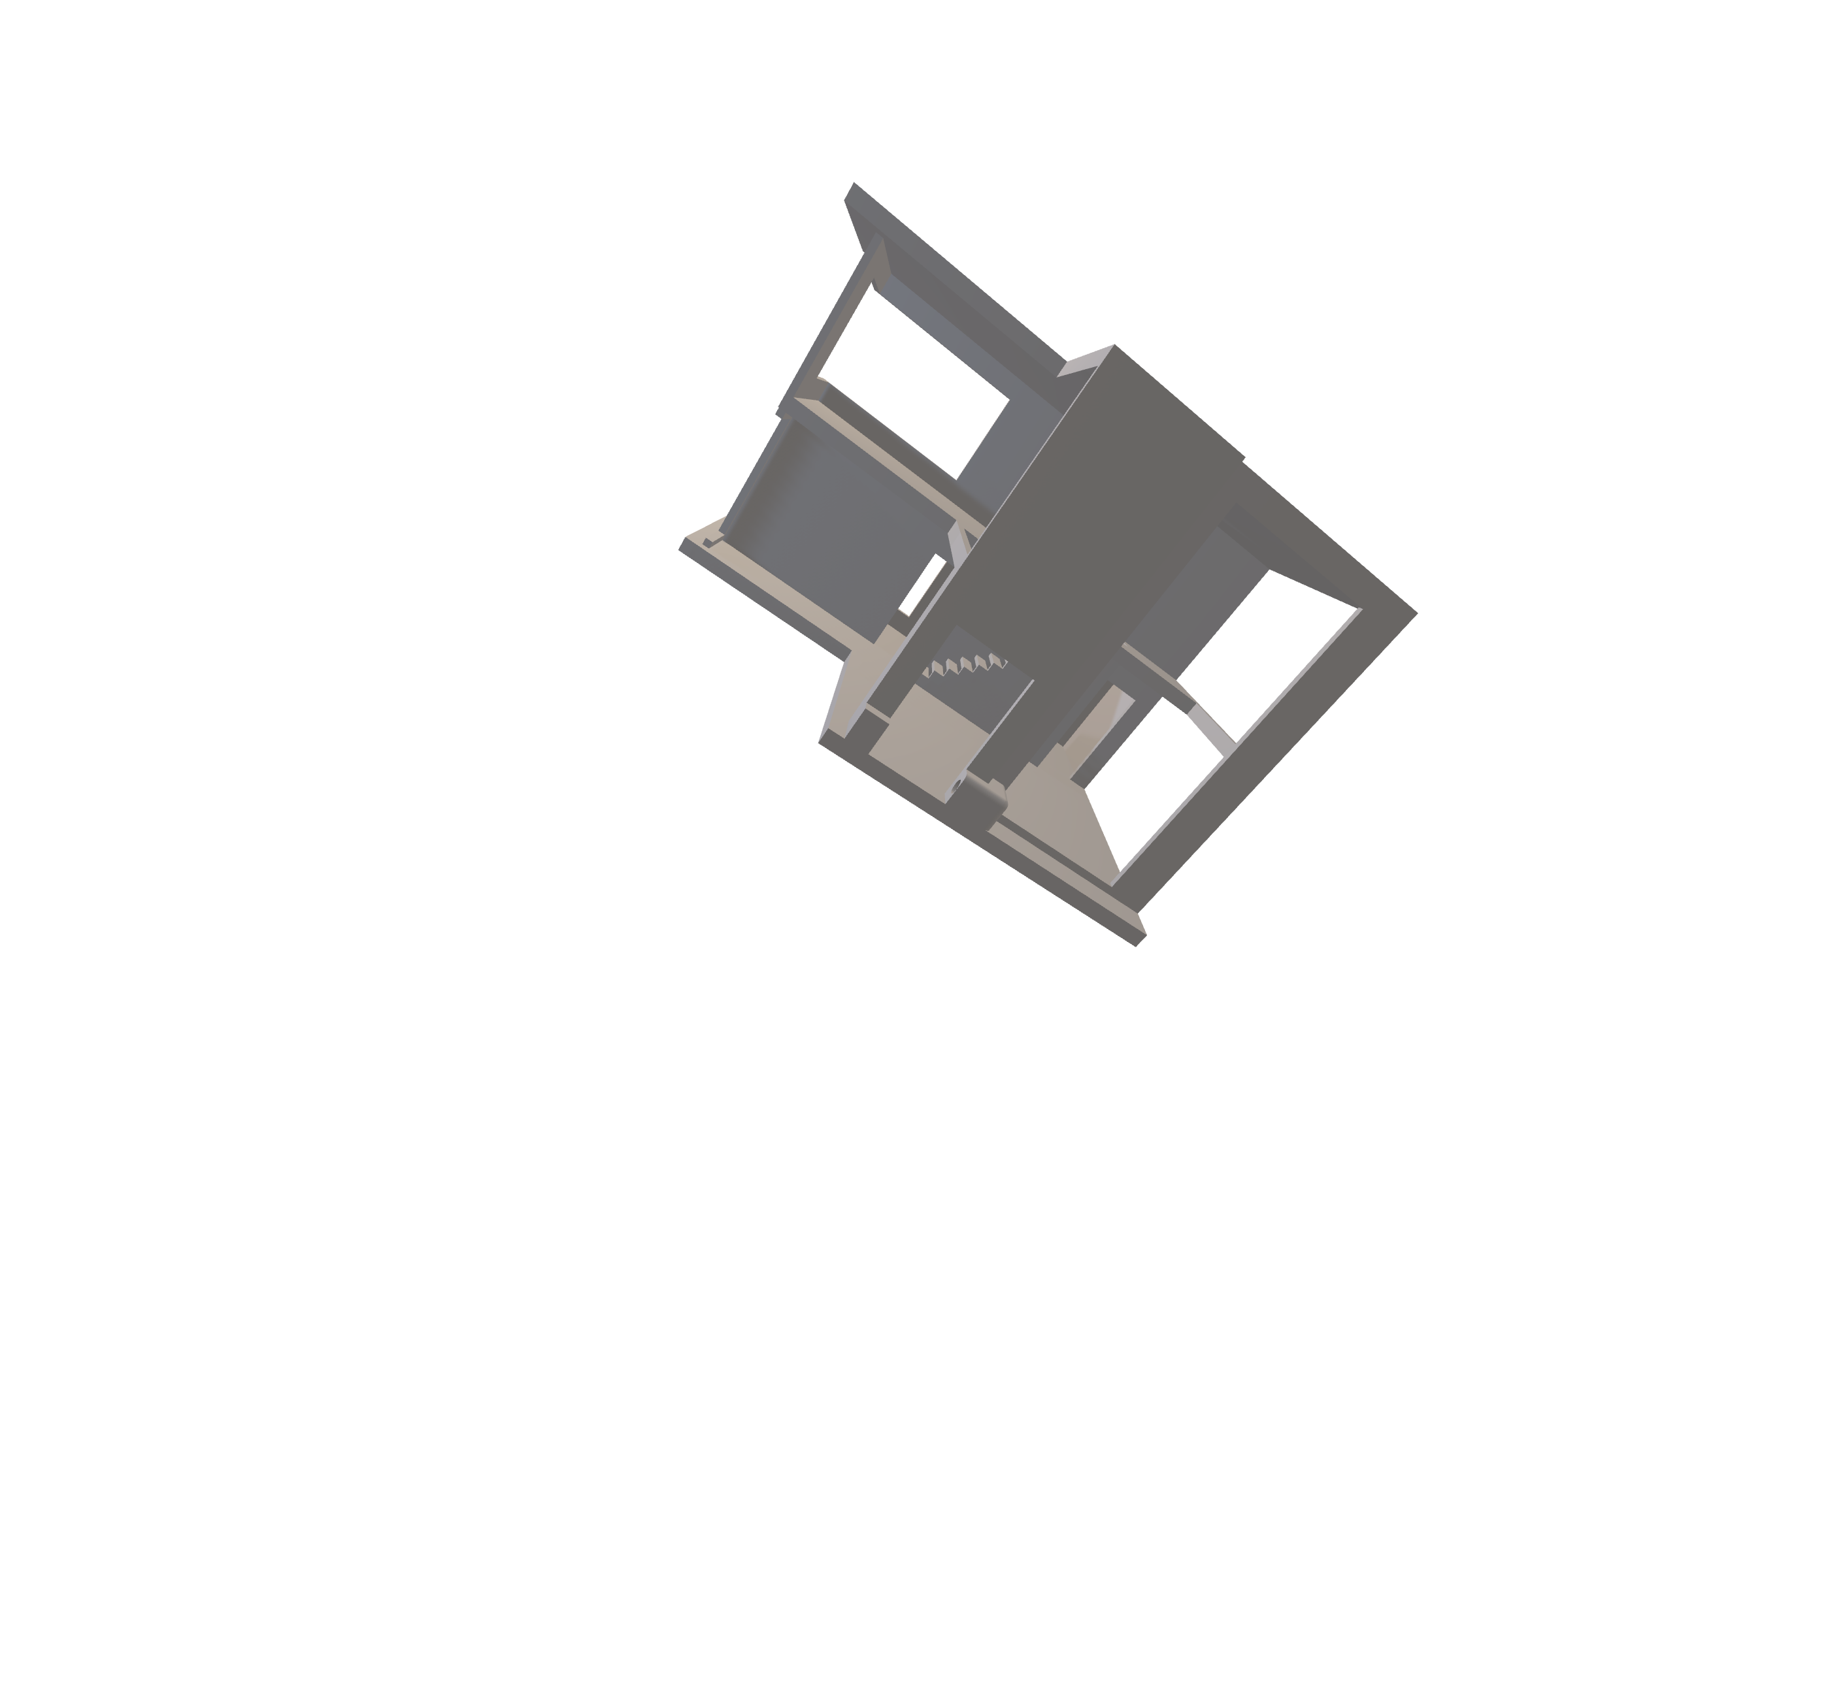
Elevator
place
Garage Door
Solar Tracker
Integrating Solar Panels promotes Eco-friendly energy usage that’s why we've incorporated a cutting-edge sun tracker system that utilizes LDR sensors to follow the sun's movement, ensuring optimal efficiency and maximizing battery charging time. This innovative solution not only harnesses Clean Energy but also provides Power for your home's needs, making sustainability effortless and cost-effective.

Slide 10

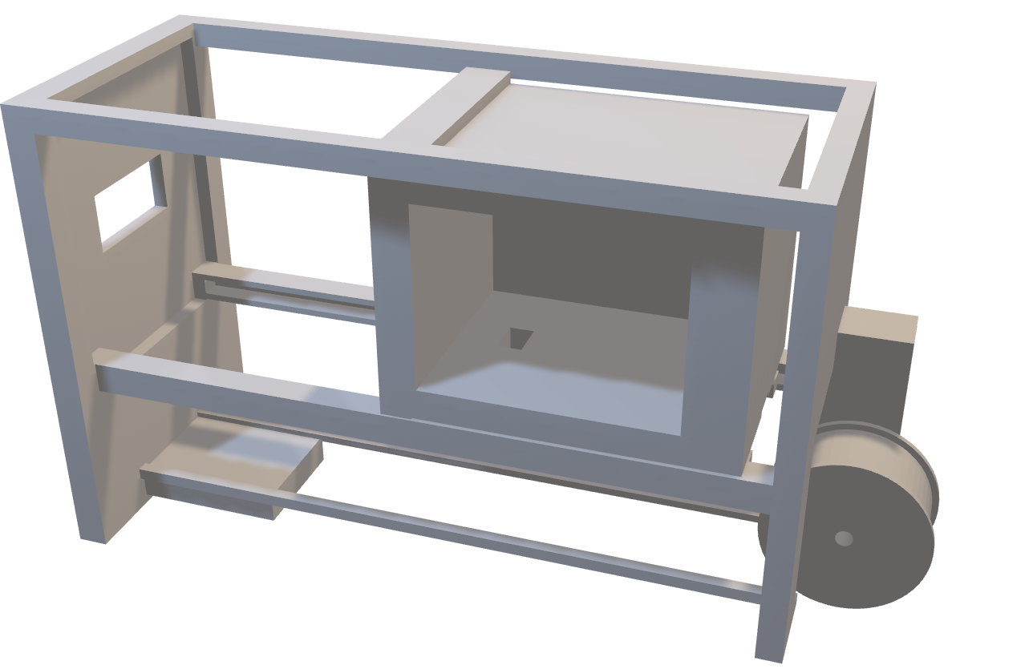
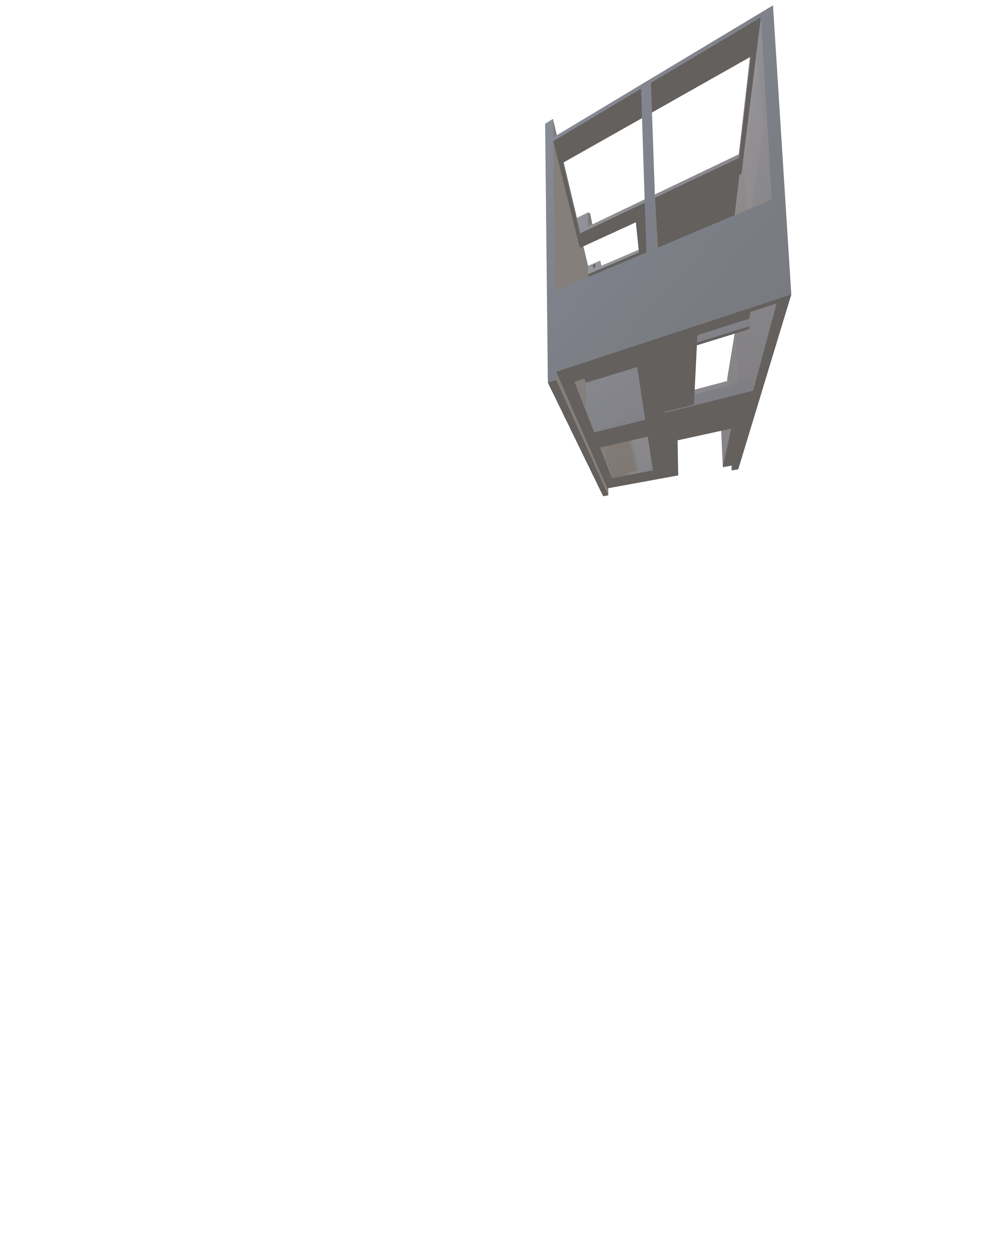

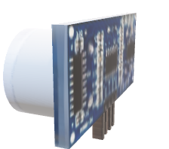
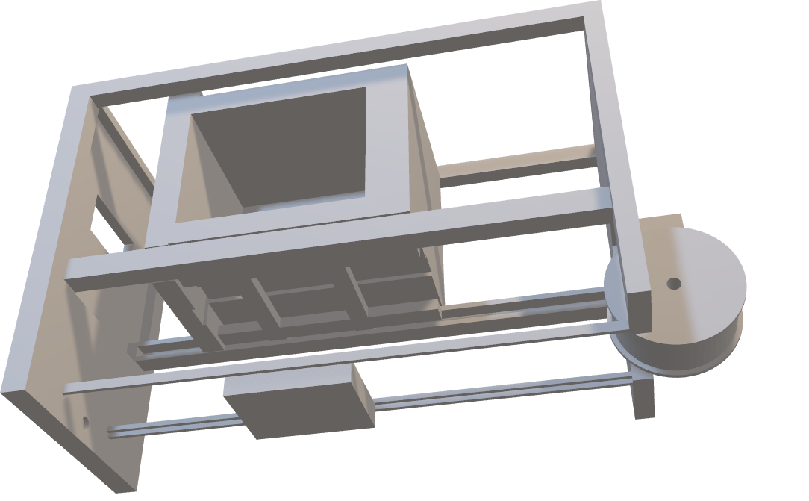
Solar Tracker
With the integration of an ultrasonic sensor, the movement of the home elevator is precisely controlled, ensuring it reaches the correct destination when called by push buttons on each floor. This advanced technology guarantees smooth and reliable operation for ultimate convenience and safety.
Elevator
place
For those seeking to enhance accessibility and mobility within their homes, the installation of home elevators emerges as an exceptional choice. By seamlessly integrating these elevators into residential spaces, individuals can effortlessly navigate between different floors, thereby promoting independence and convenience in daily living.

Slide 11



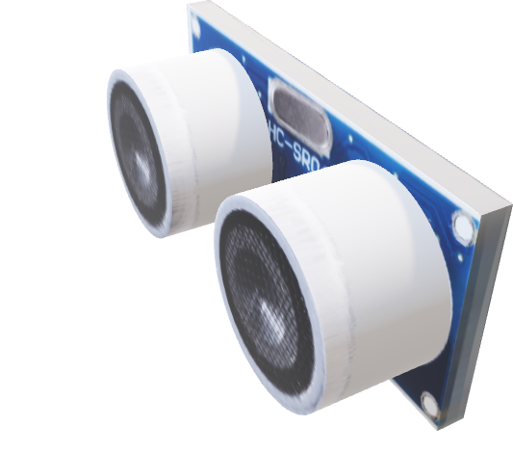
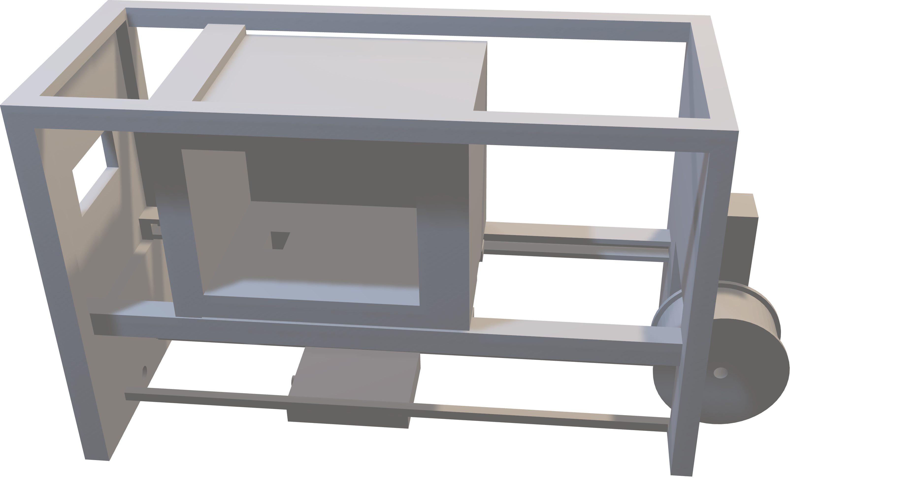
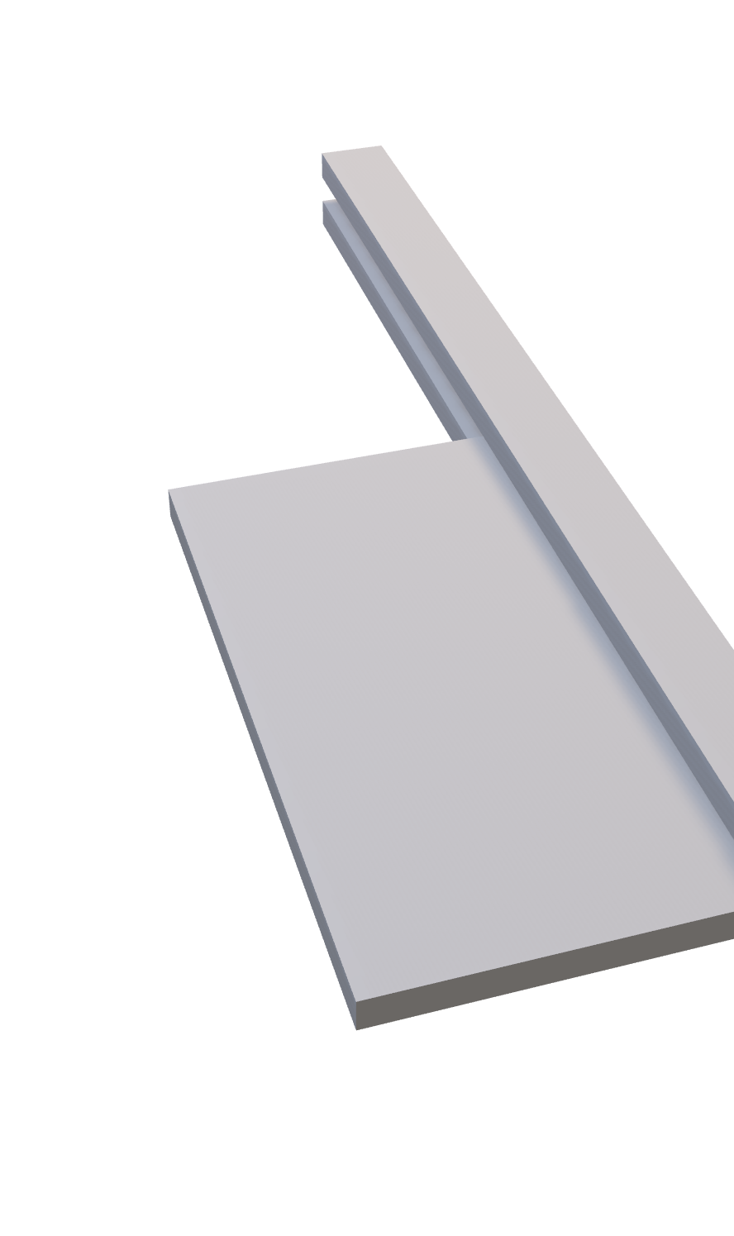
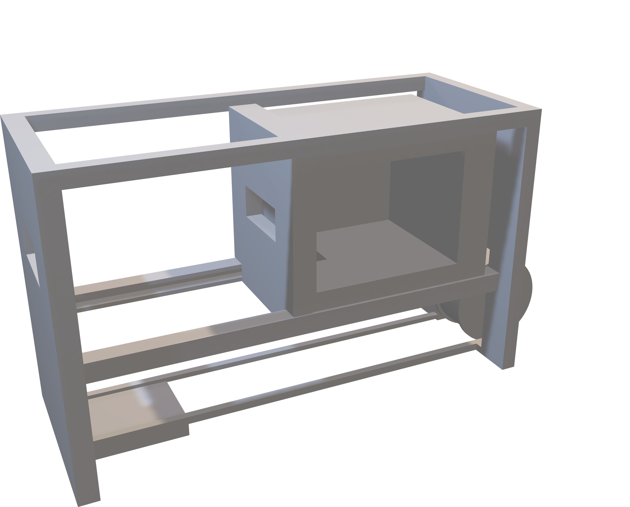
Garden Gate
Elevator
place
Enhance your home's security with an RFID-controlled gate, offering seamless opening and closing with cards or key fobs. This technology assigns unique, hard-to-replicate codes to each user, ensuring secure access while entering and exiting. Unlike passcode keypads, RFID systems support numerous users and provide superior durability and convenience.
With the integration of an ultrasonic sensor, the movement of the home elevator is precisely controlled, ensuring it reaches the correct destination when called by push buttons on each floor. This advanced technology guarantees smooth and reliable operation for ultimate convenience and safety.
1
2
3
For those seeking to enhance accessibility and mobility within their homes, the installation of home elevators emerges as an exceptional choice. By seamlessly integrating these elevators into residential spaces, individuals can effortlessly navigate between different floors, thereby promoting independence and convenience in daily living.
4
5
6

Slide 12
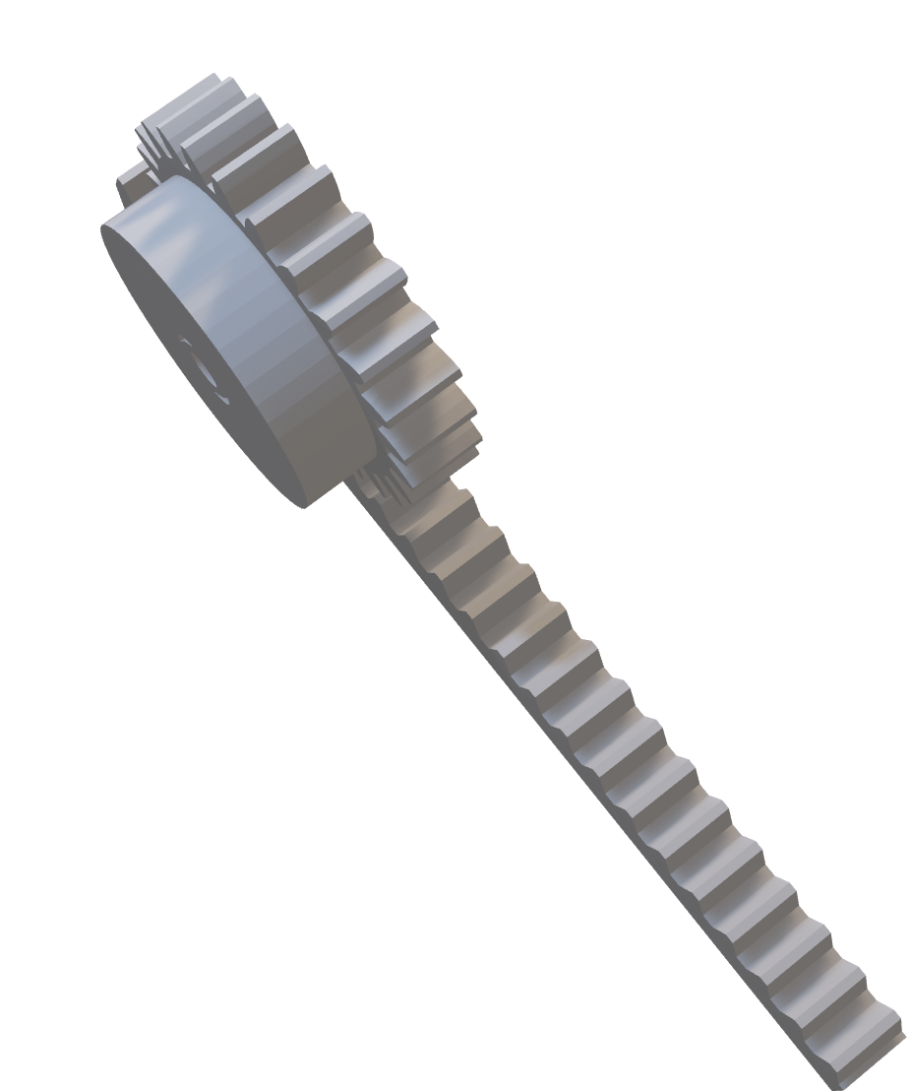
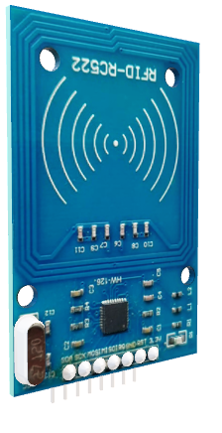
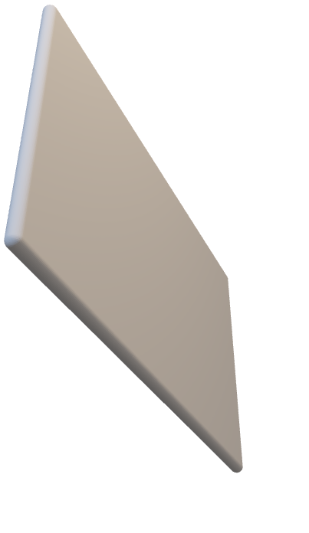
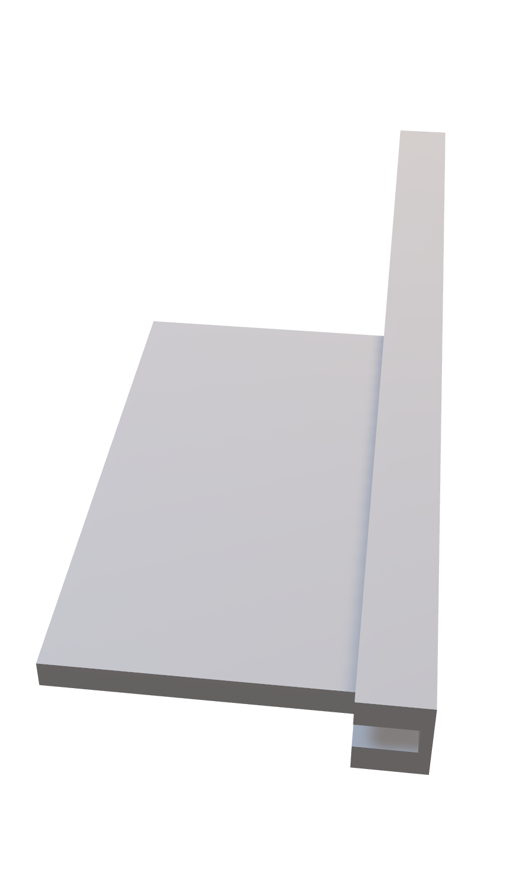
1
2
3
4
5
6
Our advanced rack and pinion system, powered by a servo motor, guarantees smooth and precise motion. This cutting-edge technology ensures reliable and accurate performance, making it an ideal solution for those seeking superior mechanical control and efficiency.
Garden Gate
Enhance your home's security with an RFID-controlled gate, offering seamless opening and closing with cards or key fobs. This technology assigns unique, hard-to-replicate codes to each user, ensuring secure access while entering and exiting. Unlike passcode keypads, RFID systems support numerous users and provide superior durability and convenience.

Slide 13

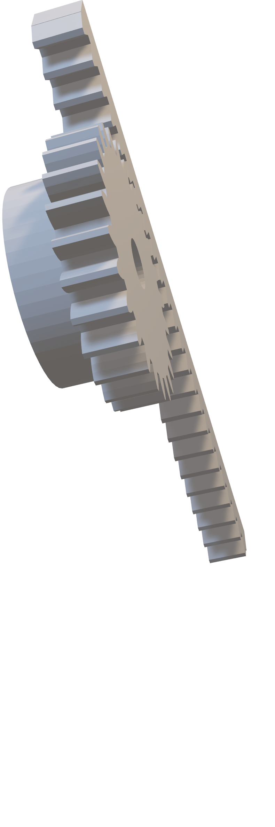
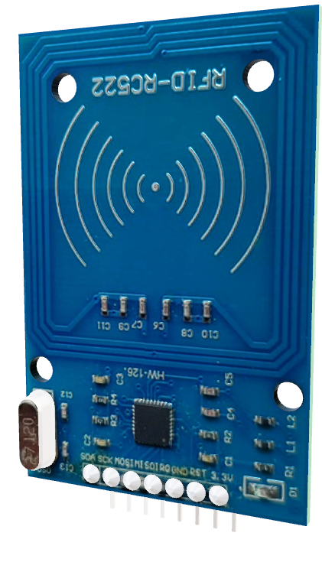

Garden Gate
Enhance your home's security with an RFID-controlled gate, offering seamless opening and closing with cards or key fobs. This technology assigns unique, hard-to-replicate codes to each user, ensuring secure access while entering and exiting. Unlike passcode keypads, RFID systems support numerous users and provide superior durability and convenience.
Our advanced rack and pinion system, powered by a servo motor, guarantees smooth and precise motion. This cutting-edge technology ensures reliable and accurate performance, making it an ideal solution for those seeking superior mechanical control and efficiency.

Slide 14
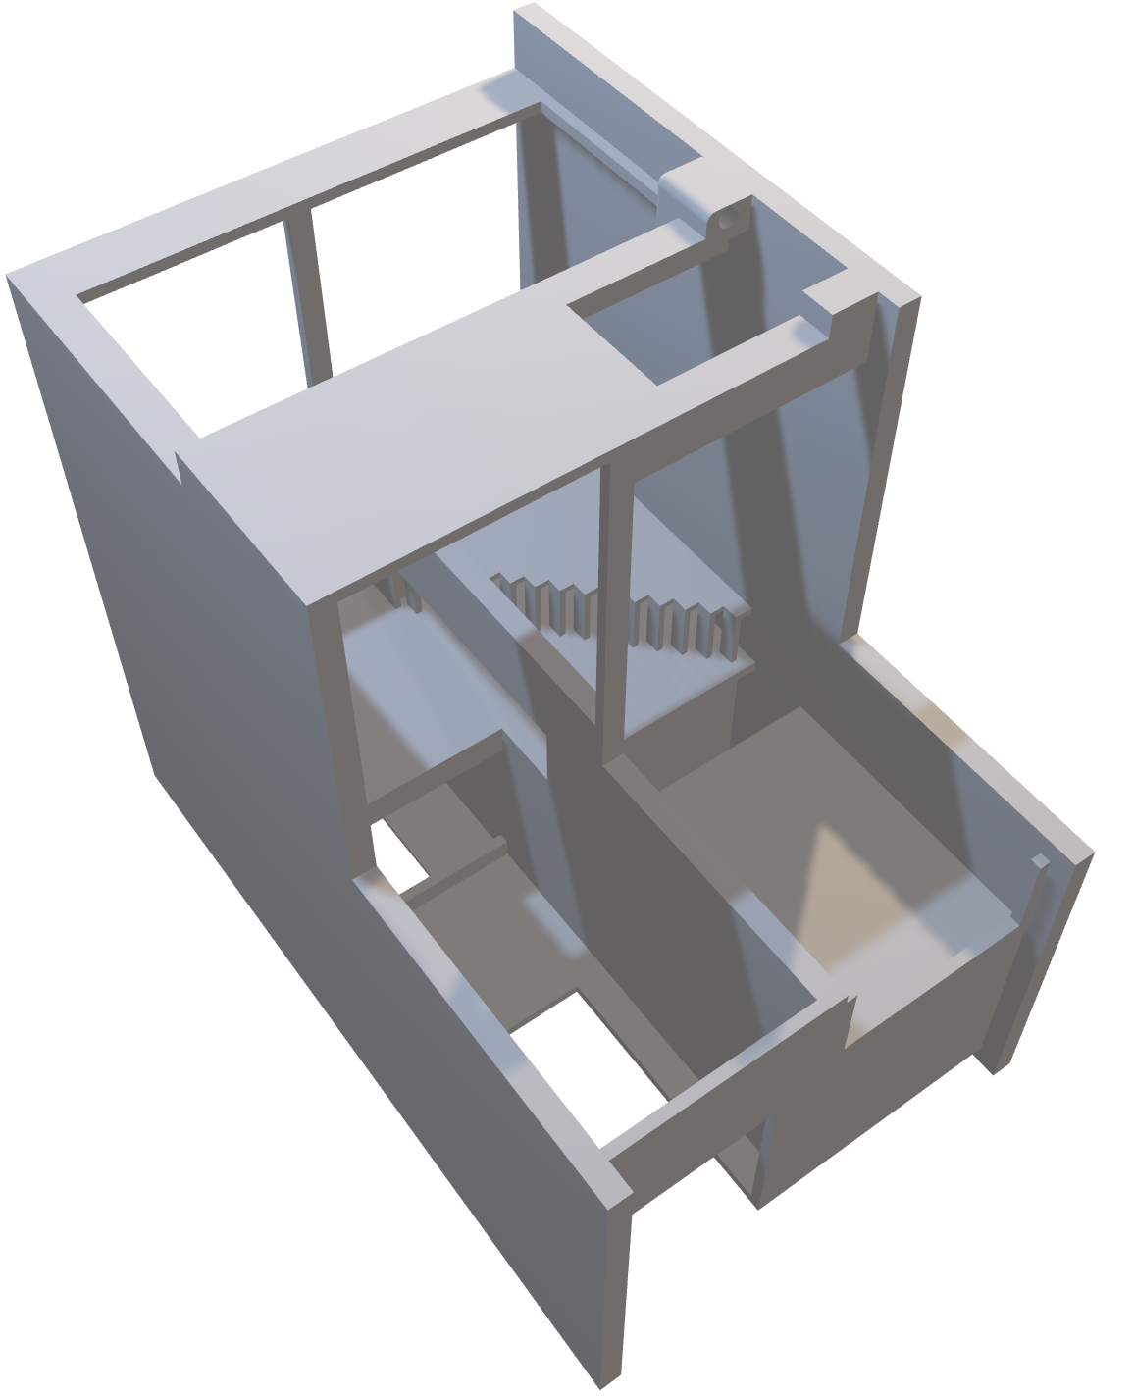
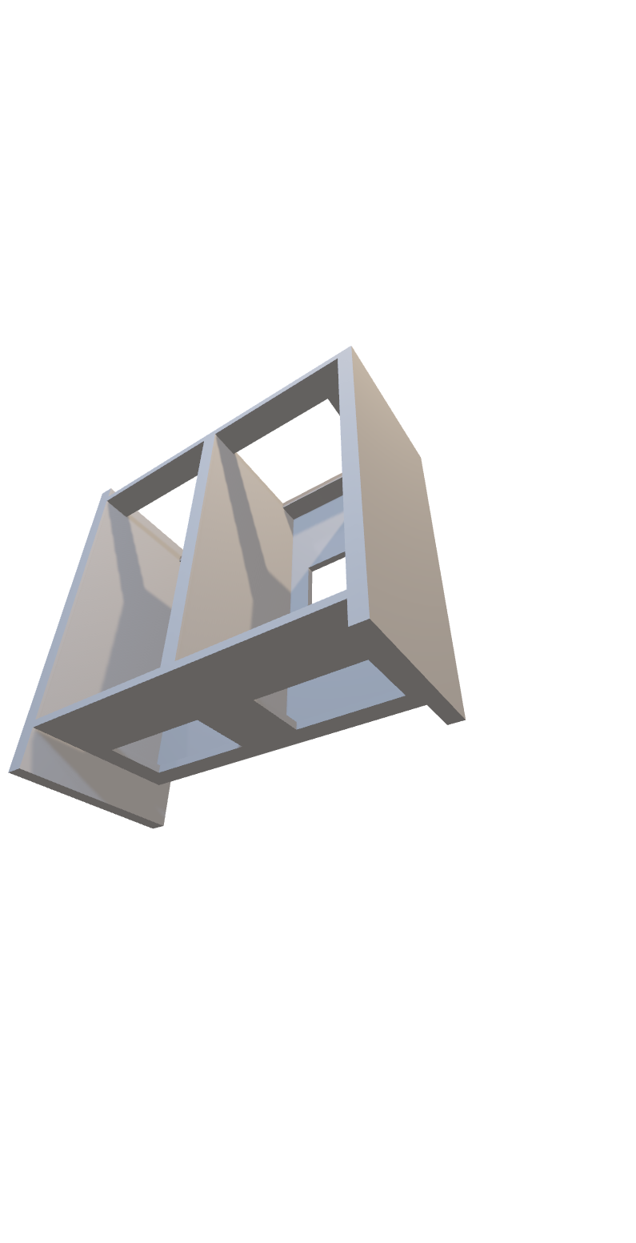
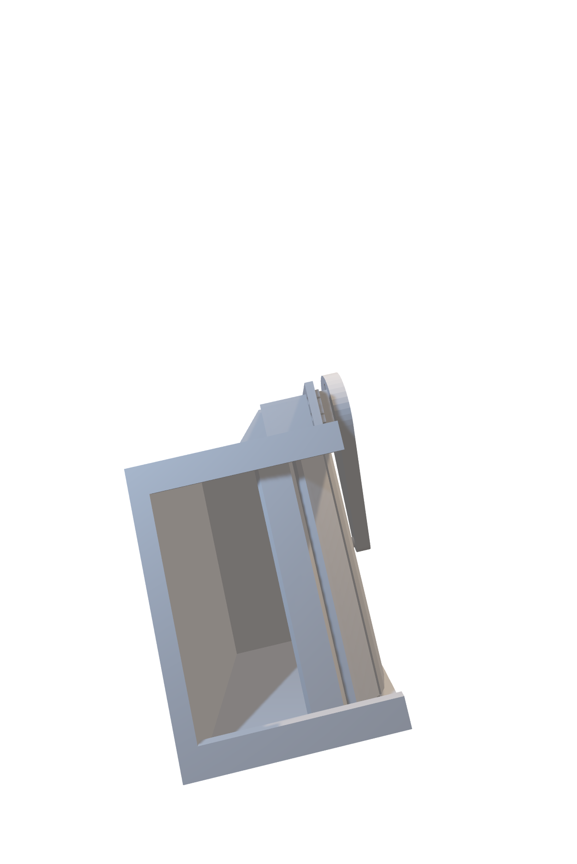
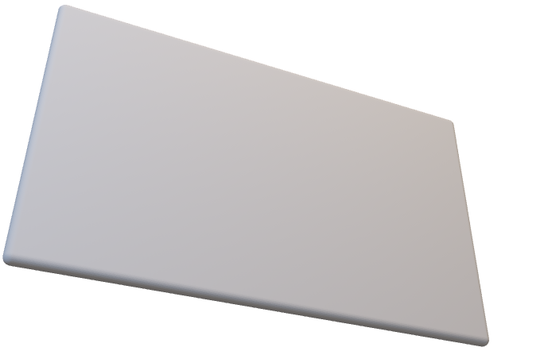
Our advanced rack and pinion system, powered by a servo motor, guarantees smooth and precise motion. This cutting-edge technology ensures reliable and accurate performance, making it an ideal solution for those seeking superior mechanical control and efficiency.

Slide 15
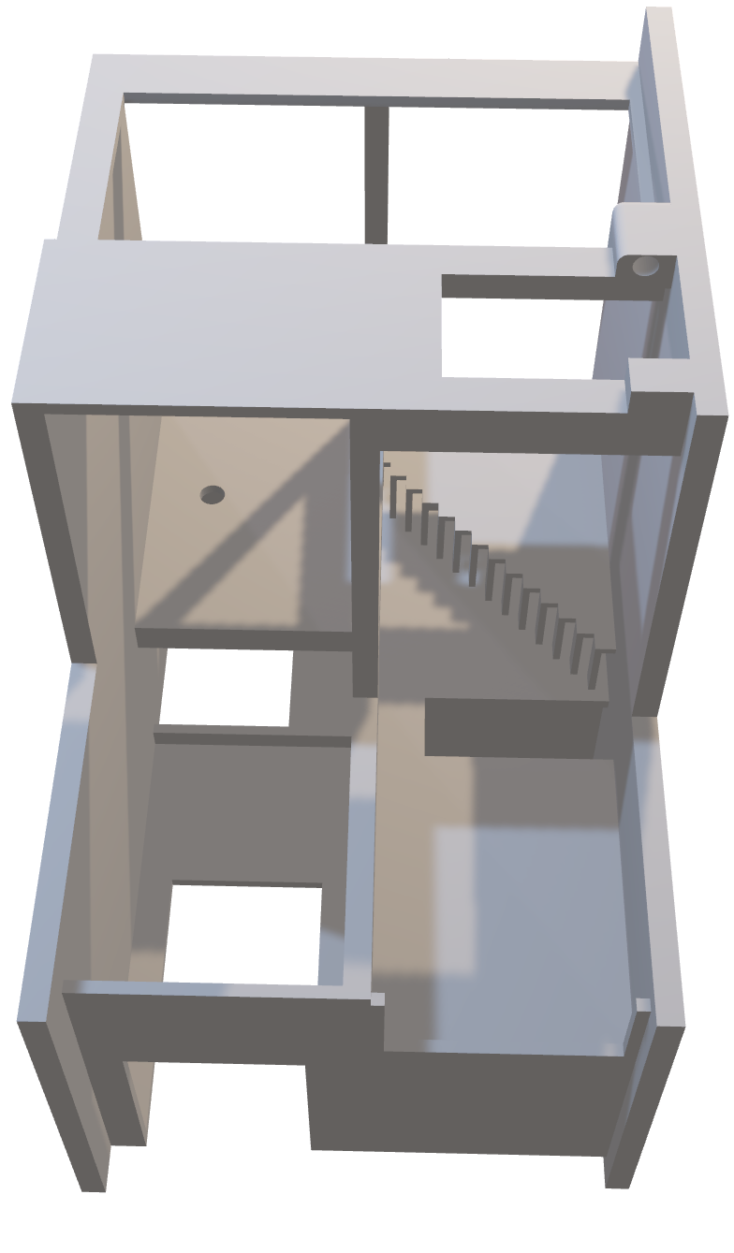
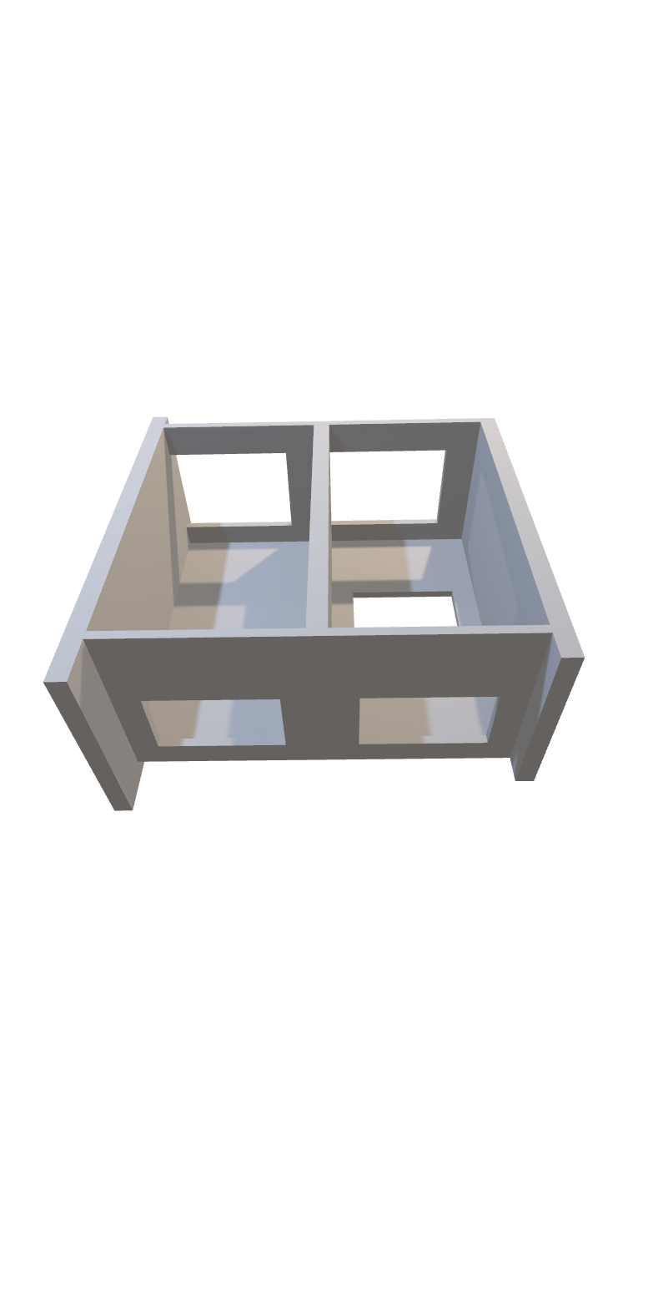

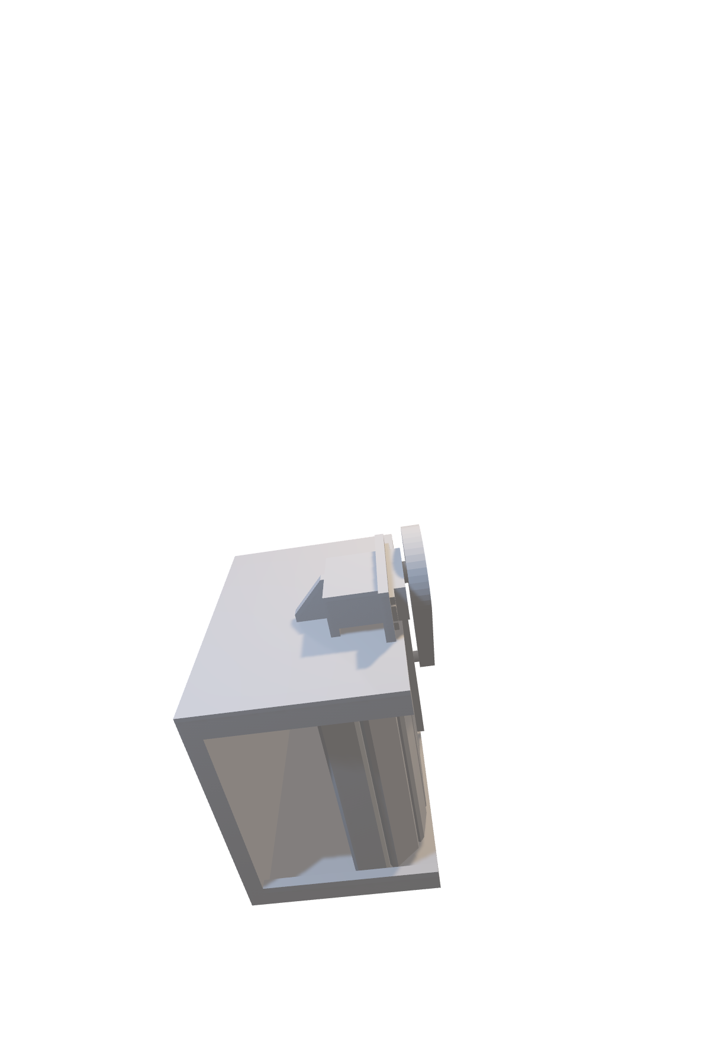
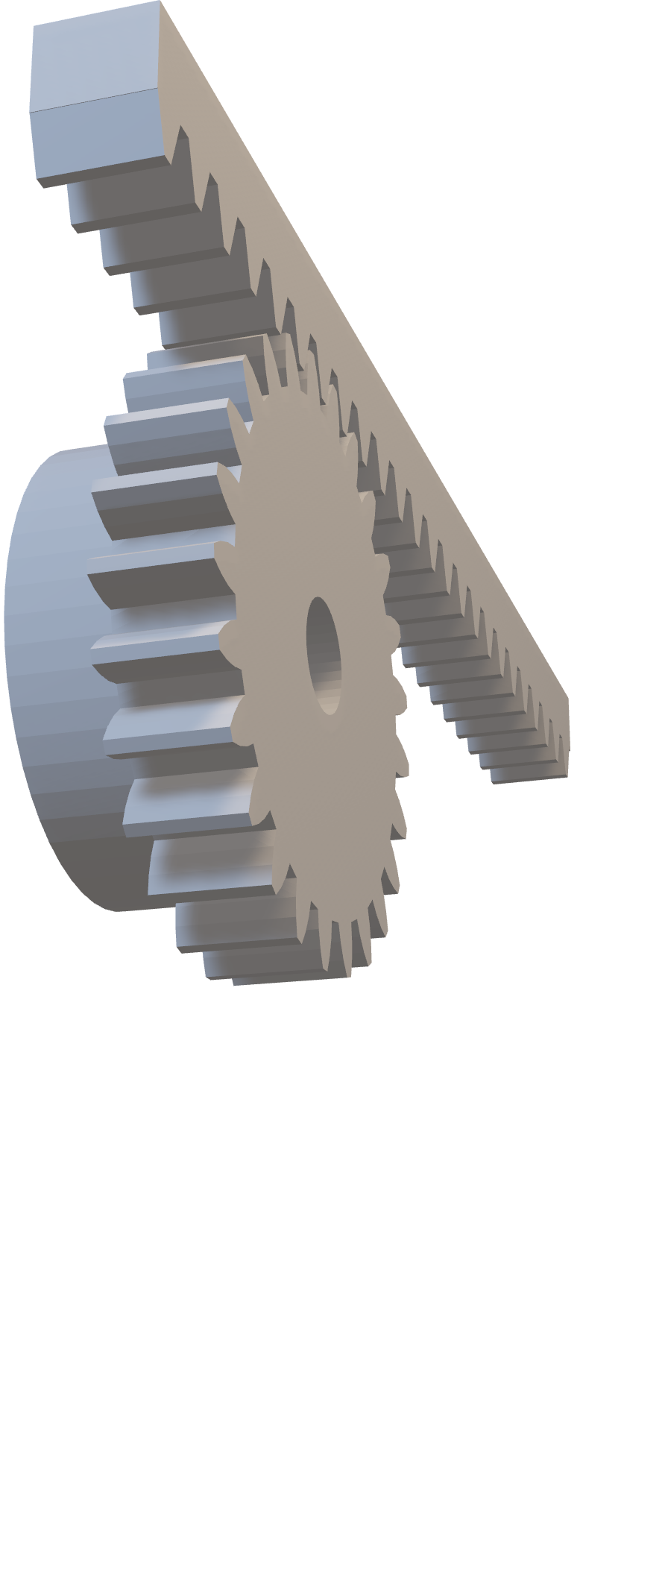
Our advanced rack and pinion system, powered by a servo motor, guarantees smooth and precise motion. This cutting-edge technology ensures reliable and accurate performance, making it an ideal solution for those seeking superior mechanical control and efficiency.

Slide 16

Your Smart Home Awaits

Slide 17
Ready to Make the Switch?

